Slide 1
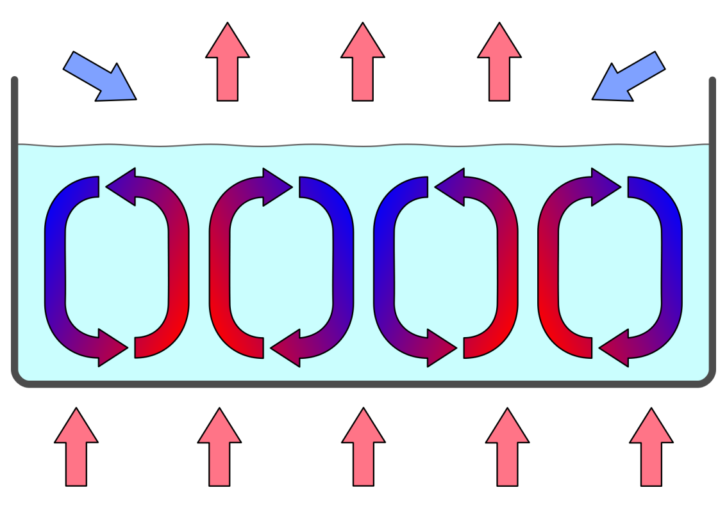
Conduction, Convection, and Radiation
© Copyright 2015 – All rights reserved. www.cpalms.org
Notes:
Image credit:
Wikimedia Commons; https://commons.wikimedia.org/wiki/File:ConvectionCells.svg (CC BY-SA 3.0)

Slide 2
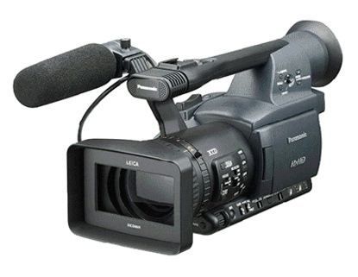
Motivational Video
YouTube: “Conduction, Convection, and Radiation” by Andi Lucas
Write down three facts you learn while watching the video!
© Copyright 2015 – All rights reserved. www.cpalms.org
Notes:
The teacher will introduce the topic by showing the motivational video. Direct the students to write down three facts that they learn from the video.
Image credit:
Wikimedia Commons; https://commons.wikimedia.org/wiki/File:Sonyhdrfx1.jpg (public domain)

Slide 3
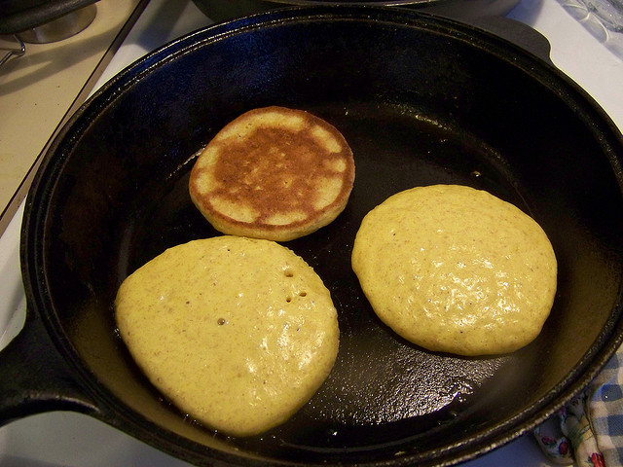
Conduction
© Copyright 2015 – All rights reserved. www.cpalms.org
Notes:
The teacher will state that the picture represents conduction: the pancakes are receiving direct heat from the skillet.
Image credit:
Alyss, Flickr; https://www.flickr.com/photos/alyssssyla/3361571920 (CC BY-NC-SA 2.0)

Slide 4
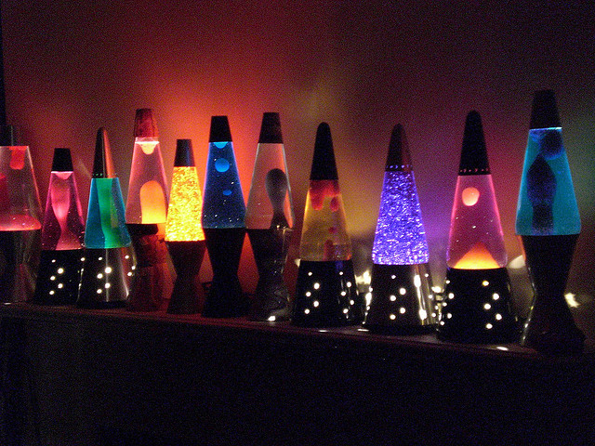
Convection
© Copyright 2015 – All rights reserved. www.cpalms.org
Notes:
The teacher will explain the mobility of the particles in the transfer of heat. Hot water rises and cold water sinks—or in the case of lava lamps, the hot “lava” rises from the bottom and falls from the top as it cools.
Image Credit:
PacoScott, Flickr; https://www.flickr.com/photos/ttocsland/548316147/in/photostream/ (CC BY-NC 2.0)

Slide 5
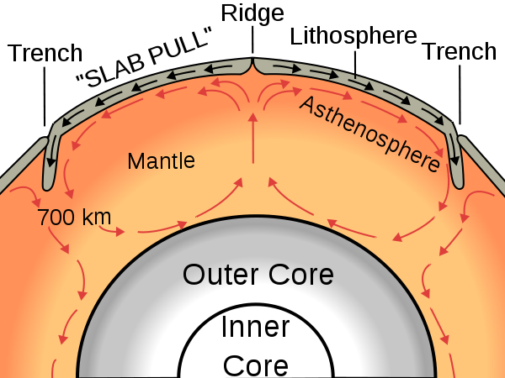
Convection in the Earth’s Mantle
© Copyright 2015 – All rights reserved. www.cpalms.org
Notes:
The teacher can mention that convection occurs in the Earth’s mantle as shown in the diagram. Again, there is movement of particles from hot to cool areas.
Image credit:
Wikimedia Commons; https://commons.wikimedia.org/wiki/File:Oceanic_spreading.svg (CC BY-SA 3.0)

Slide 6
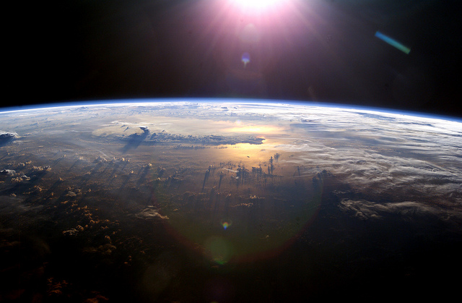
Radiation
© Copyright 2015 – All rights reserved. www.cpalms.org
Notes:
The teacher can describe radiation as a means of heat transfer via electromagnetic radiation, which does not require a physical medium. The sun warms the earth through radiation of its electromagnetic energy, which includes infrared, visible light, and ultraviolet light.
Image credit:
NASA’s Marshall Space Flight Center, Flickr; https://www.flickr.com/photos/nasamarshall/5091372229 (CC BY-NC 2.0)

Slide 7
Comparing the Three Forms of Energy Transfer
Conduction | Convection | Radiation
Direct contact | Particles move through a medium | Particles do not move through a medium
© Copyright 2015 – All rights reserved. www.cpalms.org
Notes:
The teacher will instruct students to draw the chart. They will fill in as much as they can at this point.
After about 5 minutes proceed to the next slides which will provide more information.

Slide 8
Conduction
Conduction: Exchange of heat by direct contact
Air warmed on the pavement
Making popcorn on the stove
Meat on a frying pan
© Copyright 2015 – All rights reserved. www.cpalms.org
Notes:
The teacher can use this slide to assist students, if needed, in completing the chart in slide 7

Slide 9
Convection
Convection: Transfer of heat in liquids and gasses through rising and falling currents
Air near the ceiling is warmer than air near the floor
Some large birds ride rising air currents when they fly
Water molecules rising and falling as a kettle boils
© Copyright 2015 – All rights reserved. www.cpalms.org
Notes:
The teacher can show this slide to assist the students will completing the chart in slide 7.

Slide 10
Radiation
Radiation: Transfer of heat by electromagnetic waves
A hamburger staying warm under a glowing heat bulb
Toasting a marshmallow by a campfire
Getting a sunburn after laying out in the sun
© Copyright 2015 – All rights reserved. www.cpalms.org
Notes:
The teacher can use this slide to assist students in completing the information in the chart on slide 7.

Slide 11
Vocabulary Triangle
Word
Picture representing the word
Definition of the word
© Copyright 2015 – All rights reserved. www.cpalms.org
Notes:
The teacher will inform the students that they will use the format shown in this slide for the vocabulary activity.

Slide 12
Lab Activity Student Rotation Directions
Proceed to stations 1, 2, and 3.
Station 1 students go to station 2
Station 2 students go to station 3
Station 3 students go to station 1
This activity will continue until the students complete all the stations.
© Copyright 2015 – All rights reserved. www.cpalms.org
Notes:
This slide should be used to assist student lab activity rotations.

Slide 13
Closure
Exit question:
Explain the main differences between the three types of heat transfer.
© Copyright 2015 – All rights reserved. www.cpalms.org
Notes:
The teacher will use this activity as an exit strategy. The teacher will ask the students to answer the question.

