Slide 1
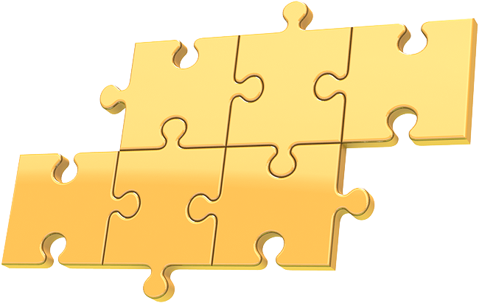
Jigsaw what were the causes of World War II?
The Spanish Civil War
&
Nationalism
Economic problems
The Peace of Paris
Aggression on the march
The rise of dictatorships
The failure of appeasement
Step 1: Students get into six groups of four
Step 2: Each student picks up a part in the puzzle
Step 3: Each student goes to the research table that pertains to the puzzle piece selected
Step 4: Student groups review the research materials given to them about one specific cause of World War II.
Step 5: Student groups discuss and create a bulleted list that summarizes about 10 important facts of topic
Step 6: Students return to their original groups, teach other members about specific topics, and all students record all of the bulleted information from each specialty group into their handouts given by teacher to be used as a study guide for an upcoming assessment.

