Slide 1
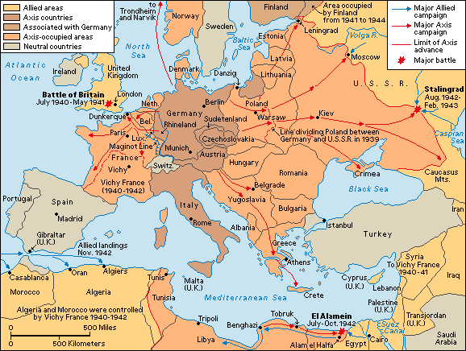
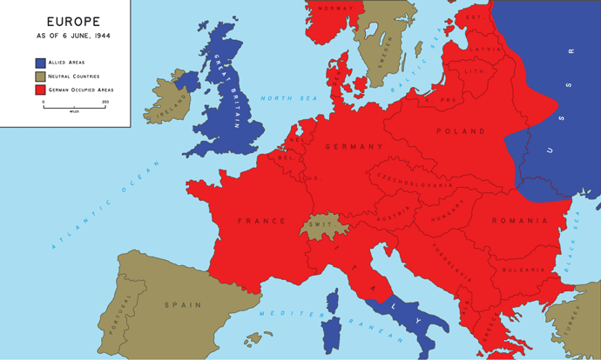
Cooperative Group Journal Entry 2
Map of Europe 1939- 1942
Map of Europe on June 6, 1944
Journal Entry #2: In your group, discuss the differences in the two maps above, and record your thoughts, feelings, and concerns.

