Slide 1
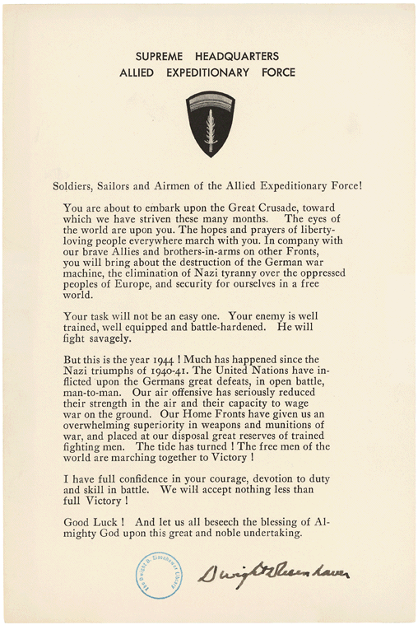
Journal Entry 5
On June 4, 1944, Collins wrote in his diary “We all got letters from Gen. Eisenhower about us going on the invasion. The letter was serious, about how the Germans would fight savagely and everything, but it made me feel good” (Myers, 1999, p. 7)
Prompt: Review the character value empathy listed below. How would you feel upon reading this letter if you were in Collins’s shoes?
Empathetic: A person that is able to identify with the state, feelings, and/or experiences of other person. One is able to see from the perspective of another. Antonym: unsympathetic, heartless, cruel, merciless, cold-blooded, ruthless
Example: If I was a soldier in the Army, and I received this letter, I would feel ________________ because……
National Archives. Order of the Day Image [Online image]. Retrieved July 17, 2013 http://www.worldbookonline.com/student/extmedia?id=ar146180&st=omaha+beach&em=pc316336

